Slide 1
Land use change between forestry and agriculture under the NZ ETS
Author: Yue Wang
Co-authors: Stephen Poletti, Golbon Zakeri, Joon Hwan(John) Kim, Basil Sharp

Slide 2
Motivation
How does the NZ ETS effect land use change between forestry and agricultural sectors?
ETS is a key pillar approach to NZ climate change
Largest emissions come from agriculture, forestry sequestrate carbon and was first enter into the ETS(MPI, 2012)

Slide 3
Model
Base year: 2007
Steady-state forestry model links to the CGE
NZ—small open economy
12 sectors, 5 types of land, factors (labor, capital) are mobile among sectors, land is mobile among 5 land-used sectors, joint production
one household, government, enterprise, investment-savings, rest of world
Four carbon tax scenarios ($0, $25, $50, $100)

Slide 4
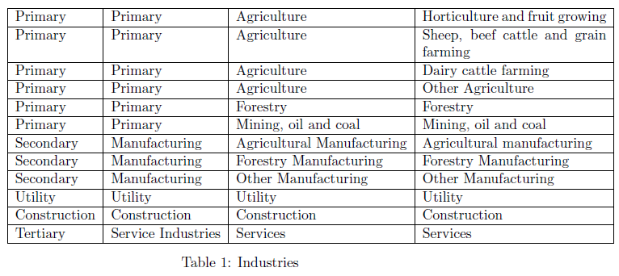
Sectors
Land-used sectors

Slide 5
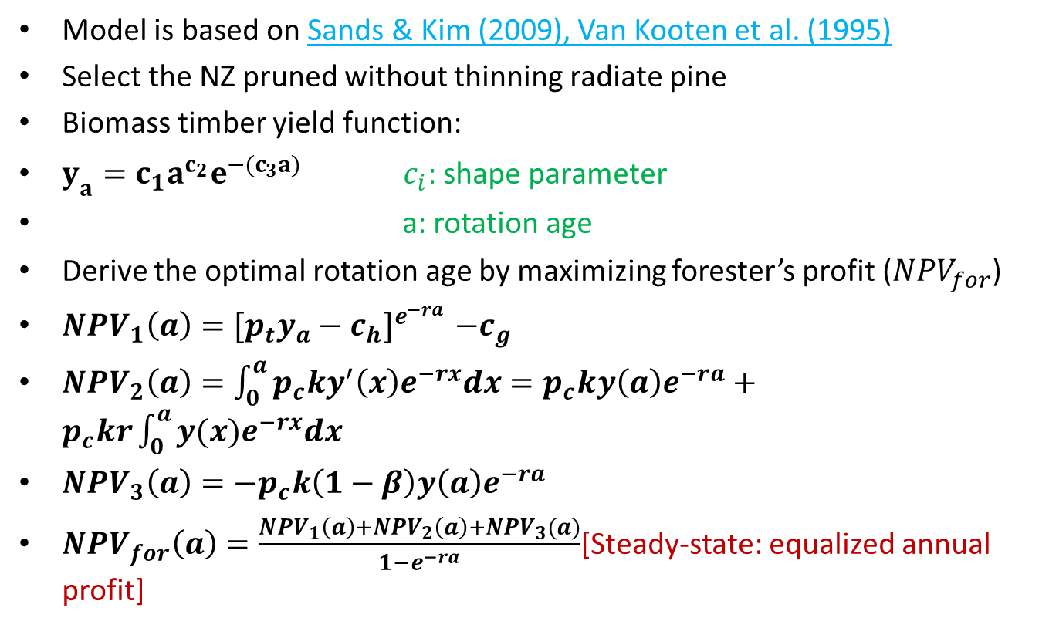
Forestry
Model is based on Sands & Kim (2009), Van Kooten et al. (1995)
Select the NZ pruned without thinning radiate pine
Biomass timber yield function:
$y_{a}=c_{1}a^{c_{2}}e^{−(c_{3}a)}$ $c_{i}$: shape parameter
a: rotation age
Derive the optimal rotation age by maximizing forester’s profit (${NPV}_{for}$)
${NPV}_{1}\left(a\right){=[p_{t}y_{a}−c_{h}]}^{e^{−ra}}−c_{g}$
${NPV}_{2}\left(a\right)=\int_{0}^{a}{p_{c}ky^{′}\left(x\right)e^{−rx}dx}=p_{c}ky\left(a\right)e^{−ra}+p_{c}kr\int_{0}^{a}{y(x)e^{−rx}dx}$
${NPV}_{3}\left(a\right)=−p_{c}k\left(1−β\right)y\left(a\right)e^{−ra}$
${NPV}_{for}\left(a\right)=\frac{{NPV}_{1}\left(a\right)+{NPV}_{2}\left(a\right)+{NPV}_{3}(a)}{1−e^{−ra}}$[Steady-state: equalized annual profit]

Slide 6
CGE production
Three-level nesting, Leontief function at the top level and between domestic and imported
Allow substitution between value-added input
Sector
Leontief
Intermediate
Value-added
Leontief
CES
Domestic
Import
Capital
Labor

Slide 7
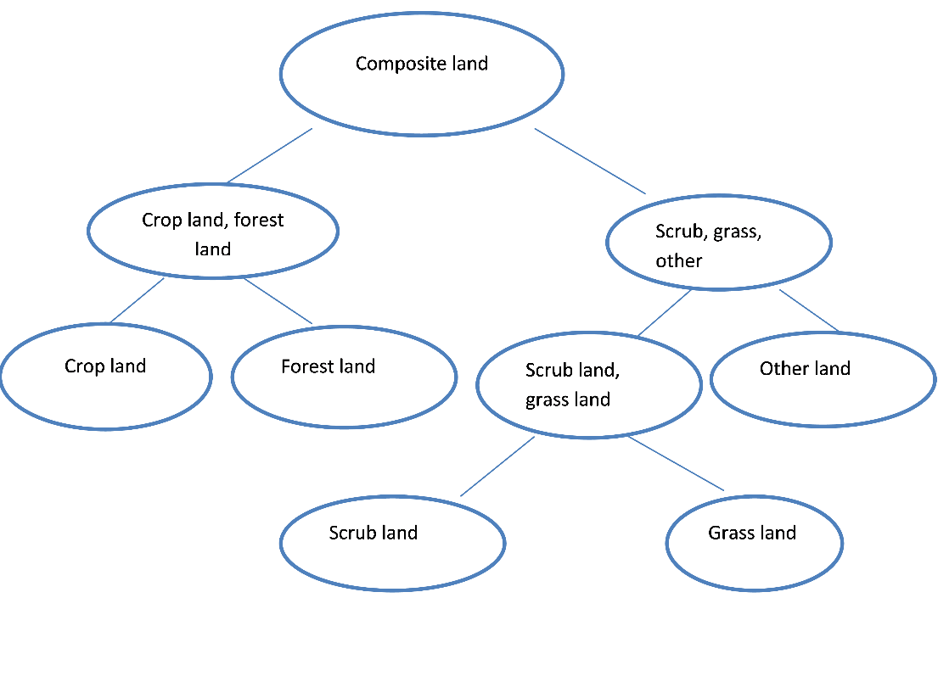
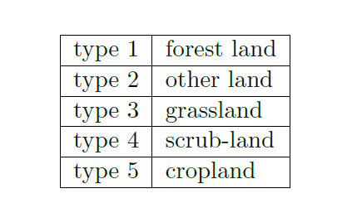
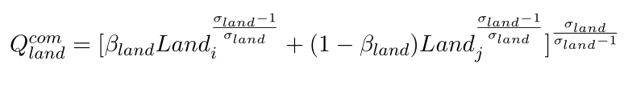
Land allocation
Five types of land; assuming a composite land used in the sector production. The Armington substitution (CET) is allowed for land allocation

Slide 8
Rest of world
Domestic consumption: domestic output and imported goods (CET)
The exchange rate is endogenous, world price is exogenous
Foreign savings are exogenous
Export consumption: exported output and domestic commodities (CET)

Slide 9
Agents
Representative household: maximize utility, using the Linear expenditure system (LES) to seek the optimal level of commodity demand
Government: Supply capital, collect tax from production, income, carbon emission, Leontief consumption
Investment-Savings: Johanson macro-closure; exogenous investment and endogenous savings
Enterprise: capital supplier
Market clearing: both factor and commodity markets clear

Slide 10
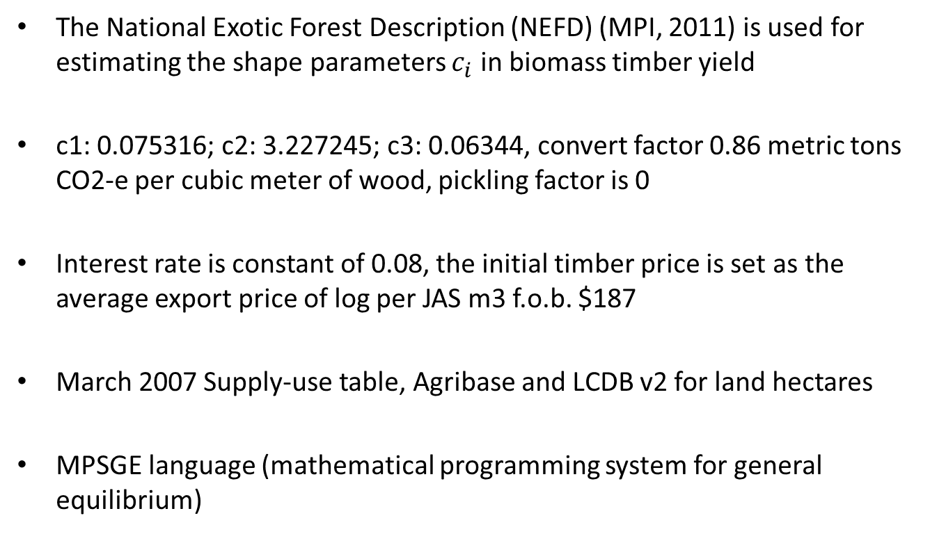
Data
The National Exotic Forest Description (NEFD) (MPI, 2011) is used for estimating the shape parameters $c_{i}$ in biomass timber yield
c1: 0.075316; c2: 3.227245; c3: 0.06344, convert factor 0.86 metric tons CO2-e per cubic meter of wood, pickling factor is 0
Interest rate is constant of 0.08, the initial timber price is set as the average export price of log per JAS m3 f.o.b. $187
March 2007 Supply-use table, Agribase and LCDB v2 for land hectares
MPSGE language (mathematical programming system for general equilibrium)

Slide 11
Results - Forestry
Forestry | Pc=0 | Pc=25 | Pc=50 | Pc=100
rotation year | 19.631 | 20.227 | 20.815 | 22.046
yield | 322.612 | 342.103 | 361.516 | 402.479
timber price | 186.983 | 190.7 | 196.009 | 200.558
NPV1 | 12521.38 | 12912.65 | 13381.43 | 13814.62
NPV2 | 0 | 2065.423 | 4224.047 | 8790.557
NPV3 | 0 | -1458.28 | -2940.39 | -5933.08
NPV4 | 15808.61 | 16863.16 | 18086.09 | 20121.07
Notes:
Higher carbon tax extends the rotation age. NZ is price taker to the world price, timber price in NZ dollars is going up.

Slide 12
Results - Land price change
Land price is increasing due to the strong demand. Forestry land increases the most.
 | pc=0 | pc=25 | pc=50 | pc=100
LForest | 0.997 | 4.021 | 9.925 | 19.629
LOther | 1.033 | 1.319 | 2.391 | 4.25
LGrass | 1 | 1.121 | 1.742 | 2.635
LScrub | 1.001 | 1.943 | 4.372 | 8.682
LCrop | 1 | 1.051 | 1.433 | 1.678
Notes:
Pl: land price
Pc: carbon tax (price)

Slide 13
Results - Forestland change
Forest land demand by ind (hectares) |  |  |  | Forestland use by ind/total Forestland hectares
 |  |  | pc=0 | pc=25 | pc=50 | pc=100
Horticulture and fruit growing |  |  | 0% | 0% | 0% | 0%
Sheep-beef |  |  | 42% | 3% | 1% | 0%
Dairy |  |  | 6% | 0% | 0% | 0%
Other agriculture |  |  | 2% | 0% | 0% | 0%
Forestry |  |  | 50% | 96% | 99% | 100%
Notes:
The most land used in the forestry sector is forestland. Forest land is heavily increased in the forestry sector, but is decreased by agricultural sectors.

Slide 14
Results-Other land change
Otherland demand by ind (hectares) |  |  |  | Otherland use by ind/total otherland hectares
Horticulture and fruit growing |  |  | 1% | 0% | 0% | 0%
Sheep-beef |  |  | 91% | 62% | 30% | 9%
Dairy |  |  | 4% | 2% | 1% | 0%
Other agriculture |  |  | 3% | 1% | 0% | 0%
Forestry |  |  | 2% | 34% | 69% | 91%
Notes:
The most land used in sheep-beef sector is “otherland”. Horticulture shares common feature with the forestry sector, sheep-beef reduces the “other land” use, dairy cattle remains the same “other land” use, other agriculture reduces the “other land” use change but not change much, forestry absorbs more “other land”.

Slide 15
Results-grassland change
Grassland demand by ind (hectares) |  |  |  | Grassland use by ind/total grassland hectares
Horticulture and fruit growing |  |  | 0% | 0% | 0% | 0%
Sheep-beef |  |  | 81% | 70% | 46% | 18%
Dairy |  |  | 14% | 11% | 5% | 0%
Other agriculture |  |  | 3% | 2% | 1% | 0%
Forestry |  |  | 1% | 17% | 47% | 82%
Notes:
The most land used in dairy cattle sector is grassland.
Sheep-beef sector suffers the most loss on grassland, since the grassland dominates the dairy cattle, so dairy sector increases the grassland use.

Slide 16
Results-scrubland change
Scrubland demand by ind (hectares) |  |  |  | Scrubland use by ind/total scrubland hectares
Horticulture and fruit growing |  |  | 0% | 0% | 0% | 0%
Sheep-beef |  |  | 84% | 26% | 8% | 2%
Dairy |  |  | 4% | 1% | 0% | 0%
Other agriculture |  |  | 3% | 1% | 0% | 0%
Forestry |  |  | 9% | 73% | 92% | 98%
Notes:
The ratio represents the proportion of the “scrubland” to each sector use under the four scenarios.

Slide 17
Results-cropland
Cropland demand by ind (hectares) |  |  |  | pc=0 | pc=25 | pc=50 | pc=100
 |  | Cropland use by ind/total cropland hectares
Horticulture and fruit growing |  |  |  | 17% | 15% | 12% | 3%
Sheep-beef |  |  |  | 73% | 71% | 61% | 36%
Dairy |  |  |  | 7% | 6% | 4% | 0%
Other agriculture |  |  |  | 3% | 2% | 1% | 1%
Forestry |  |  |  | 0% | 6% | 22% | 60%
Notes:
Facing a higher carbon price, dairy cattle sector still wants to use more cropland.
(1). The elasticity of demand drives the household spent more on relative cheaper “dairy” products;
(2). The dairy farming needs the cropland for production;
(3). New land comes from the sheep-beef sector.

Slide 18
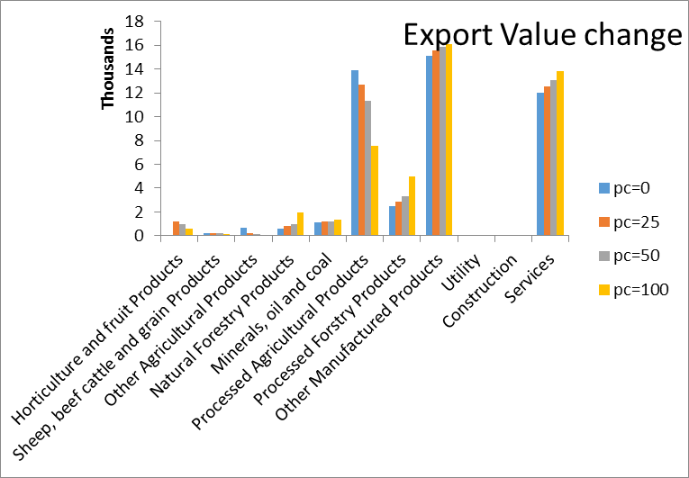

Slide 19
 | Pc=0 | Pc=25 | Pc=50 | Pc=100
Pfx | 1 | 1.02 | 1.048 | 1.073
 | Pc=0 | Pc=25 | Pc=50 | Pc=100
GDP0 | 155419.1 | 155419.1 | 155419.1 | 155419.1
GDP EX | 155419.1 | 154961 | 154221.3 | 153479.8
Notes:
GDP0 = sum(c, chh.l * ch(c) + Investment.l(c) + govtc.l * cg(c) + Export.l(c) - Import.l(c));

Slide 20
Commodity price
commodity price |  | pc=0 | pc=25 | pc=50 | pc=100
 | com1 | 1 | 1.054, | 1.111 | 1.263
 | com2 | 1 | 1.131, | 1.414 | 1.764
 | com3 | 1 | 1.049, | 1.104 | 1.215
 | com4 | 1 | 1.425, | 1.98 | 4.008
 | com5 | 1 | 1.02 | 1.048 | 1.072
 | com6 | 1 | 0.999, | 0.995 | 0.996
 | com7 | 1 | 1.060, | 1.159 | 1.314
 | com8 | 1 | 0.998, | 0.996 | 0.995
 | com9 | 1 | 1.007, | 1.017 | 1.036
 | com10 | 1 | 1.007 | 1.013 | 1.031
 | com11 | 1 | 1.000, | 1.001 | 1.004
 | com12 | 1 | 0.996 | 0.991 | 0.988

Slide 21
Import value |  |  |  | pc=0 | pc=25 | pc=50 | pc=100
Horticulture and fruit growing |  |  |  | 357.714 | 320.603 | 294.665 | 260.957
Sheep, beef cattle |  |  |  | 139.609 | 101.126 | 73.355 | 48.965
Other Agriculture |  |  |  | 381.248 | 271.696 | 201.283 | 132.225
Natural Forestry |  |  |  | 5 | 5.181 | 5.447 | 5.75
Minerals, oil and coal |  |  |  | 3120.162 | 3199.391 | 3298.78 | 3392.634
Processed Agricultural products |  |  |  | 799.979 | 676.405 | 570.1 | 459.121
Processed forestry products |  |  |  | 725.921 | 733.563 | 749.185 | 772.826
Other Manufactured products |  |  |  | 35393.46 | 35086.39 | 35012.41 | 35365.46
Utility |  |  |  | 6.999 | 6.889 | 6.853 | 6.787
Construction |  |  |  | 178.018 | 179.53 | 179.968 | 185.91
Services |  |  |  | 9532.22 | 9611.594 | 9633.297 | 9627.454
Notes:
Red marks imply an increase of the imported goods

Slide 22
Future work
Contribution:
First linking the steady state forestry model to the CGE for analyzing the land use change in NZ study. Results are more comprehensive.
Future work:
Estimation of the market clear domestic carbon credit (NZU) price

Slide 23
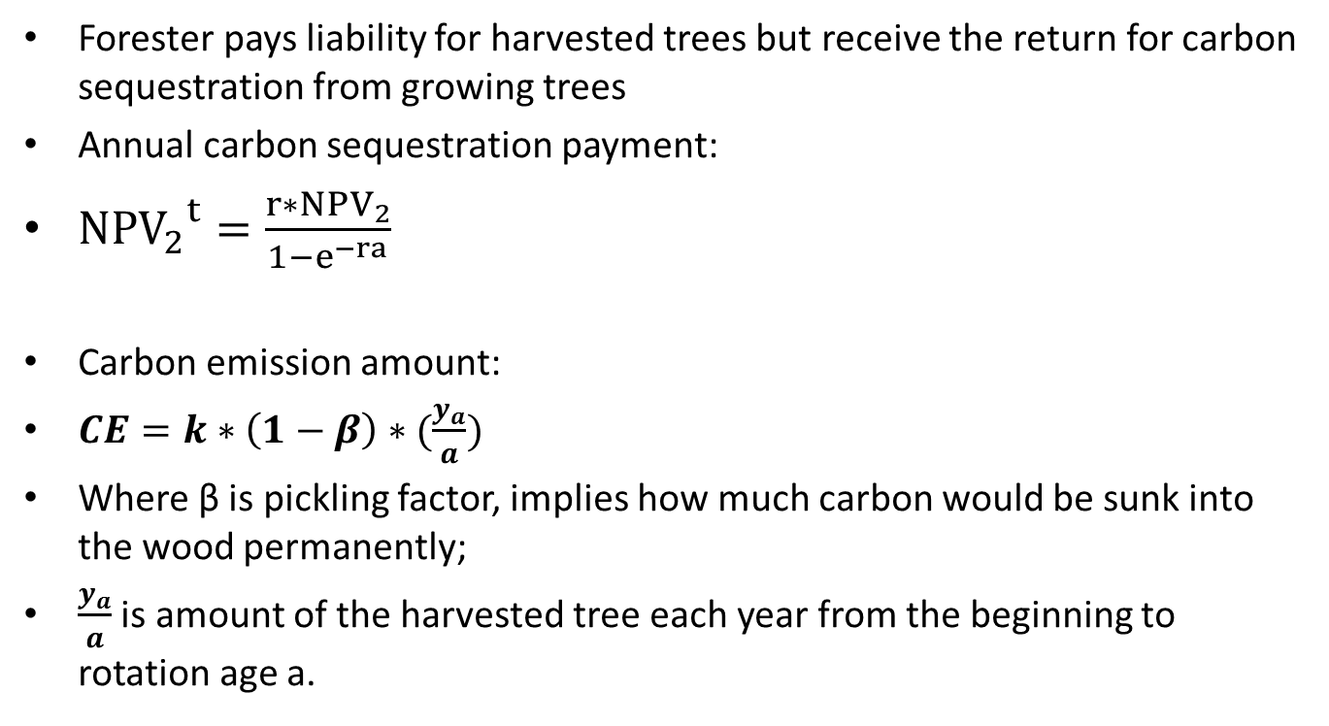
Appendix I (Forestry carbon payment)
Forester pays liability for harvested trees but receive the return for carbon sequestration from growing trees
Annual carbon sequestration payment:
${{NPV}_{2}}^{t}=\frac{r∗{NPV}_{2}}{1−e^{−ra}}$
Carbon emission amount:
$CE=k∗\left(1−β\right)∗(\frac{y_{a}}{a})$
Where β is pickling factor, implies how much carbon would be sunk into the wood permanently;
$\frac{y_{a}}{a}$ is amount of the harvested tree each year from the beginning to rotation age a.

Slide 24

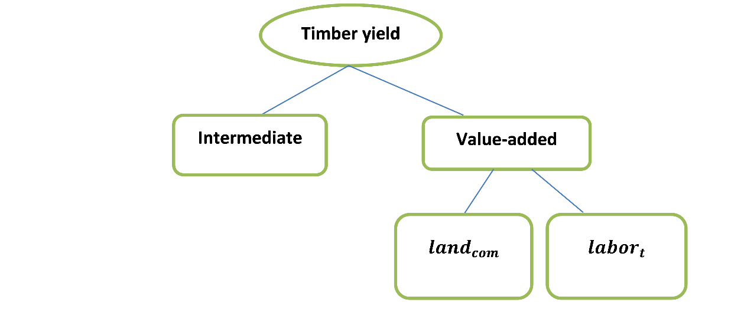



Appendix II (Timber production)
Due to the biomass timber yield function, we assume a Leontief function for timber production ($Q_{t}$). Harvested timber production is used as the intermediate for other industries (${QA}_{i}$), determined by the Leontief coefficient ($α_{i2}$, $α_{i3}$, $η_{t1}, η_{t2}$)

Slide 25
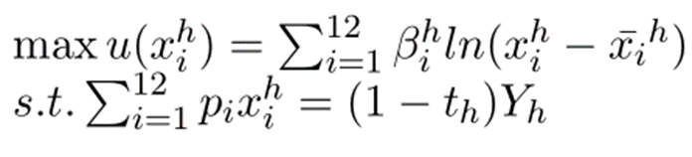
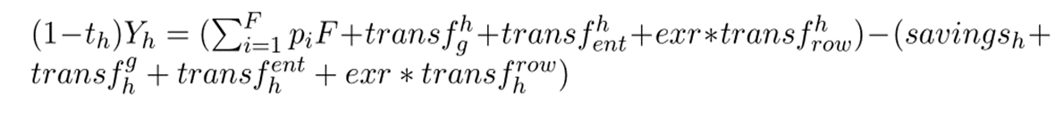
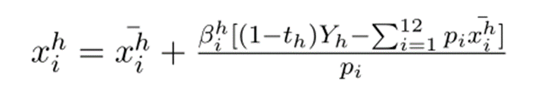
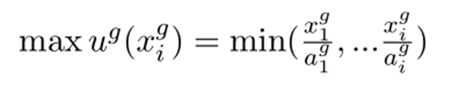
Appendix -equations

Slide 26
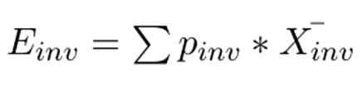
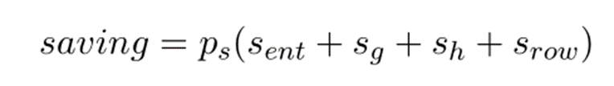

Slide 27




Market clearing
Commodity market:

Slide 28



Market clearing
Factor market

