Slide 1

Type Title Here
CGE modelling at the department of Immigration and Border Protection
Second level heading
Third level heading
Kasipillai Kandiah
Migration Policy and Planning Section
Migration Planning and Program Management Branch
Department of Immigration and Border Protection
2013 National CGE Workshop-
7 October 2013
Disclaimer: Any views formed and/ or conclusions reached in this presentation are solely those of the author and do not necessarily represent those of the Department

Slide 2
Overview of presentation
Broad overview of migration program
Brief account of TERM model
Broad outline of DIAC-TERM model
Previous CGE models studies on the economic impacts of immigration in the Australian economy
Data used in DIAC-TERM model
Closure of the model
Policy scenarios
Macro results
Sectoral results
Regional results
Questions and conclusions

Slide 3

Australia’s Migration Programs
Permanent Migration Program
Temporary
Humanitarian
Ongoing policy revision
Set by Government
Set by Government
Hybrid model: demand-and supply-driven
Demand-driven
Annual planning
Annual planning
for Federal Budget
Planning process involves evidence based research and consultations with stakeholders
Temporary programs include the 457 skilled workers, students and working holiday visa with work rights. Largely demand-driven and therefore not set annually.
Notes:
SLIDE THREE
The three broad groups of programs are represented on this slide.
On one side of this slide is the temporary visa programs – students, tourists, working holiday makers and temporary skilled workers. These are demand-driven and are not subject to a numerical limits.
On the other side of the slide is the humanitarian program – for refugees and people in humanitarian need. It has an annual planning level and is managed separately.
The Migration Planning is a complex process and entails several months of evidence-based planning work to present to Government with a submission for the planning levels for the coming year. The submission is considered by the Government as part of its Budgetary process.
3

Slide 4
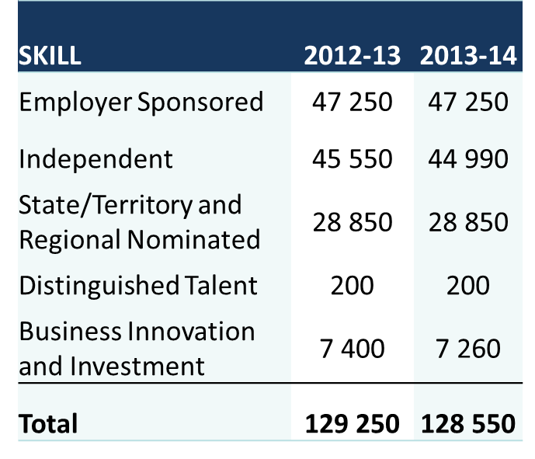
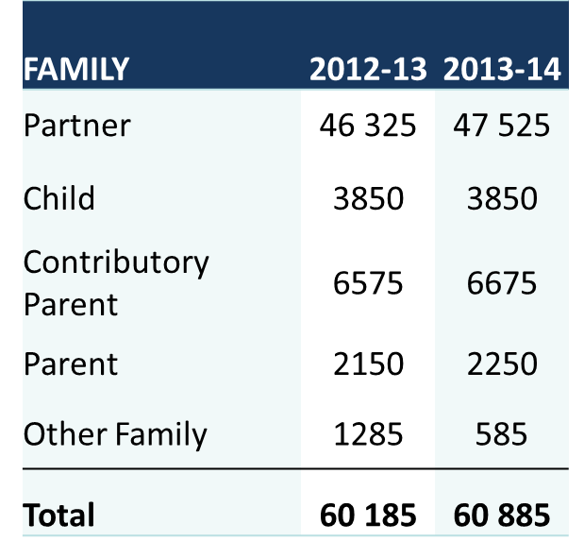
Permanent Migration Program
Notes:
SLIDE FOUR
The next year’s program reflects the issues raised in the development of the submission.
Stakeholders expressed views that the program size was meeting needs but acknowledged that the pressures in the family stream needed to be addressed.
This year, politically, it is a challenging environment as well with the announcement of the Election.
The 2013-14 Program retained the program size of 190 000
There has been a slight compositional shift from Skill to Family of 700 places.
This shift reflects the demand for places in family and also the softening labour market conditions
Still supporting skill needs and targeted needs based migration.

Slide 5
Empirical studies used CGE in Australia
What have the Australian migration modelling found?
The productivity commission report (2005) using the MONASH Model found that the skilled migration intake increase of 50% from 2004-05 level had a positive overall impacts but impacts were minimal.
Giesecke (2006) used MONASH dynamic equilibrium model to examine the economic impact of a 50% increase in the skilled migrant intake and found that main aim of the policy is to increase the scale of the economy.
ACIL Tasman (2011) used GTAP model to examine the potential economy wide impact of changes to skilled migration. The study found that improving the integration and flexibility of the skilled migrant workforce will produce substantial economic benefits.
Notes:
SLIDE FIVE
Other empirical studies with reference to migration related to Australia (SLIDE FIVE)
The Productivity Commission (PC) report finds that migration has a positive impact on the Australian economy. This report used Monash Model to investigate the economic impacts of skilled migration program on the Australian economy by increasing the skilled migration intake by 50% from the level of 78, 000 from 2004-05 to 2025. This increase was equivalent of increasing 39,000 per annum. Overall the report concluded that these impacts were positive in many respects but impacts were minimal. This study finds that a 50% increase in skilled migration has brought about lower real GNP per capita for the first 12 years of the increased skill immigration policy, with the increase in living standard rising to 0.6 per cent above the business as usual outcome after 20 years.

Slide 6
the DIAC-TEdd
Description of the DIAC-TERM
Description of the DIAC-TERM
DIAC-TERM model
Description of the
A simple way of understanding the DIAC-TERM model is to view it in two components.
The TERM components largely determines labour demand by occupation and region; and
The labour supply component largely determines labour supply by occupation and region.
The two components are linked within DIAC-TERM model by markets by occupation and region.
The equations of the TERM model are broadly similar to those of other CGE models.
Notes:
DIAC-TERM model’s development (SLIDE SIX)
This model was developed by Professor. James Giesecke and his colleagues at the CoPS for the department of immigration and Citizenship in 2012
TERM model is employed to examine the economic impacts of hypothetical changes in the permanent migration program. DIAC-TERM model has more elaborate detail of labour supply description.
The labour supply function was added features of the model.
These labour market are defined over eight occupations and fifteen regions.
What is DIAC-TERM CGE model?
This model was developed by Prof. James and his colleagues at the CoPS for the department of immigration and Citizenship in 2012. This model contains 15 regions, 36 sectors, 36 commodities and 8 occupational grouping.
The equations of the TERM model are broadly similar to those of other CGE models.
Producers choose a cost-minimizing combination of intermediate and primary factor inputs, subject to production, functions which are structured by a series of CES "nesting" assumptions.
Two high-level aggregates, of primary factors and of intermediate inputs, are each demanded in proportion to industry output (Leontief assumption). The primary factor aggregate is a CES composite of capital, land and a labour aggregate—the latter being itself a CES composite of labour by skill group. The aggregate intermediate input is again a CES composite of different composite commodities, which are in turn CES composites of commodities from different sources—as described in detail in the next section. Industry outputs are transformed into commodity outputs via a CET mechanism that is calibrated from the MAKE matrix .

Slide 7
Labour supply Dynamics
Notes:
SLIDE SEVEN
Characteristics of working age population: Labour market functions- 8 Occupations plus short term unemployment, long-term unemployment, NIL and overseas.
Regions 15 domestic regions plus 1 Foreign
Visa Status- Citizen, skilled, Family, Humanitarian, Other permanent visas, Student, long-stay business 457, Other temporary and New Zealanders.
Skill- one skill element which is a combination of (1) University (2) Certificates and Diploma, and (3) No post school qualification.
Age – 7 age group spanning 10 years 15-24, 25-34’’’’’’’’’’’’’’’’’’’’’’’’’’’’’’’’’’’’’’’’’’’’’’’’’’’’’’’’’’’’’’’’’’’’(7)75+
The key ingredients in the labour market specification of ZAR-M are i) the division of the labour force into categories at the start of each year reflecting labour force functions of people in the previous year; ii) the identification of labour force activities, that is, what people do during the year; iii) the determination of labour supply from each category to each activity; iv) the determination of labour demand in employment activities; and v) the determination of everyone’s activity, that is, who finds employment and what happens to those who do not.

Slide 8
Advantage of DIAC-TERM
This model has a detailed account of labour supply determination.
Individuals in each category plan their labour supply by solving an optimization problem.
Model allows temporary and permanent migration program to meet the shortfall of skilled labour.
The economic impact of immigration program from the labour supply side can be examined by using DIAC-TERM model.
Different components of migration program can be considered as a source of labour supply shock.
The labour supply model includes a robust labour supply choice theory.
Notes:
Advantage of DIAC-TERM model compared to other CGE models (SLIDE EIGHT)
This model has a detailed account of labour supply determination of WAP, their functions, other characteristics of WAP such as region, visa status, skills and age.
In this model, people in each category plan their labour supply by solving an optimization problem.
This model the detailed account of labour supply would allow to, at least partially, respond through both temporary and permanent migration program to meet the shortfall of skilled labour.
The economic impact of immigration program from the labour supply side can be examined by using DIAC-TERM model. Different components migration program can be considered as a source of labour supply shock which can be imposed on the model.
The labour supply model includes a mechanism, operation during policy simulations, which allows the model to transition from a short-run labour market (wage rigidity) environment to long-run market environment characterised by real wage flexibility.
A general equilibrium approach would be more appropriate way to measure the impact of migration on both labour and capital markets while capturing any terms-of-trade effects that may arise.
The model’s labour market mechanism was the key to facilitate the detailed policy analysis.

Slide 9
DIAC-TERM Model Database
Input-Output data base: Regional Input-output data and parameters
Labour market database for the labour supply module
Notes:
Data sources:
Census of Population and housing 2006;

Slide 10
Closing the model
No unique natural or correct closure to run the model.
Closures depends on the purposes of the analysis and user determined
Decomposition closure can be best described as a standard one-period long-run closure. This closure helps develops other closures such as the forecast and policy closures.
The forecast closure is used in simulation to produce a business-as-usual picture of the economy.
In forecast simulations we use all available data and information about the future to generate a believable baseline for the economy. We use Access Economics forecast for national and state macroeconomic variables.
A baseline forecast scenario incorporating available forecast data is first simulated.
For the baseline forecast closure, we try to exogenise everything that we think we know about the future.
The policy closure is used in simulation analysing the impact of an exogenous shock to the economy beyond the natural baseline scenarios.
Policy simulations are performed as a sequence of annual solution in recursive-dynamic model. As such, this closure reflects many short-run features.
Notes:
SLIDE TEN
Many alternative closures (choice of exogenous variables) are possible in this model. That is number of endogenous variable is equal to number of exogenous variables.
Length of run, T with short run closure we assume that time is long enough for price changes to be transmitted throughout the economy, and for price-induced substitution to take effect
Decomposition closure can be best described as a standard one-period long-run closure. This closure helps develops other closures such as the forecast and policy closures.
The forecast closure is used in simulation to produce a business-as-usual picture of the economy.
In forecast simulations we use all available data and information about the future to generate a believable baseline for the economy. We use Access Economics forecast for national and state macroeconomic variables.
A baseline forecast scenario incorporating available forecast data is first simulated.
For the baseline forecast closure, we try to exogenise everything that we think we know about the future.
The policy closure is used in simulation analysing the impact of an exogenous shock to the economy beyond the natural baseline scenarios.
Policy simulations are performed as a sequence of annual solution in recursive-dynamic model. As such, this closure reflects many short-run features.

Slide 11
Policy Scenarios
The model offers the possibilities of examining the impacts of alternative components of NOM including the migration program (skilled and family)
The first scenario is to increase the migration program from 190,000 to 250,000 (about 32%) per annum up to 2022.
Second scenario is a slight increase of the migration program from 190,000 to 195,000 (2.7%) per annum for the period up to 2022.
Third scenario is to decrease of the migration program from 190,000 to 95,000 (about 53%) per annum for the period up to 2022.
Notes:
SLIDE ELEVEN

Slide 12
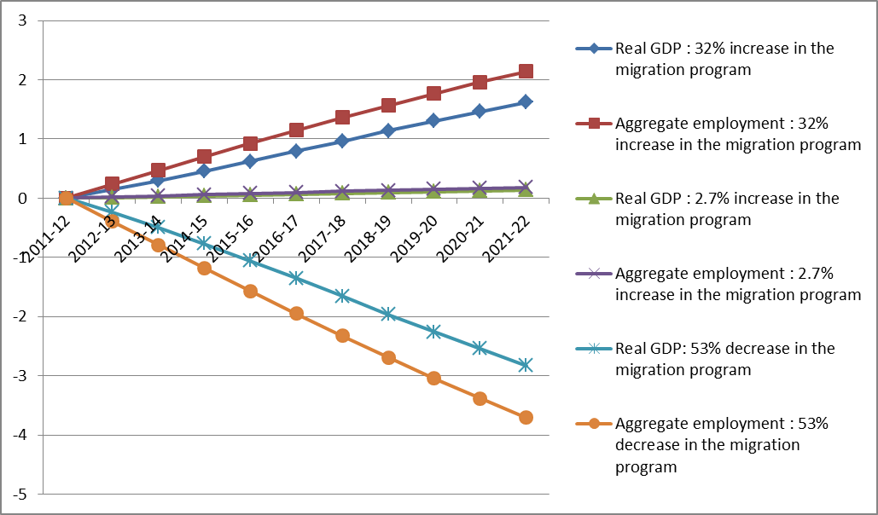
Macro results (three simulations)
Real GDP and employment (percentage deviation from baseline)
Notes:
SLIDE TWELVE
In simple world, the economy is fully scalable if the additional skilled migrants are economically equivalent to existing residents. After `12 year, the increase in skilled migrants’ means that population would be around 1.48% higher than it would otherwise be. If the skilled migrant were economically equivalent to existing residents, then this would mean that the economy would expand by about 1.48%, relative to baseline scenario. This assumes constant return to scale in production.
This simple expansion of the economy would leave living standards unaffected. While consumption would be 4% higher than otherwise, so would the population, leaving consumption per capita unaffected.
In reality, the typical skilled migrants is significantly more productive than the typical existing resident, on average they are more skilled and have a higher labour force participation rate, giving them high human wealth. This means that while over 12 years the higher level of migration is projected to contribute 1.48% population, it can be expected to expand employment.
This flows through to similarly higher percentage gains in production and capital.
Immigration can change the productivity of labour supply, measured as GDP per hour worked. Increase and /or decrease skilled migrants might, for example, be expected to lead to increase in the value added per hour worked (SKILL EFFECT). All else equal, any skill effect resulting from increasing the level of skilled immigrants should, over time, be reflected in higher average wage rates.

Slide 13
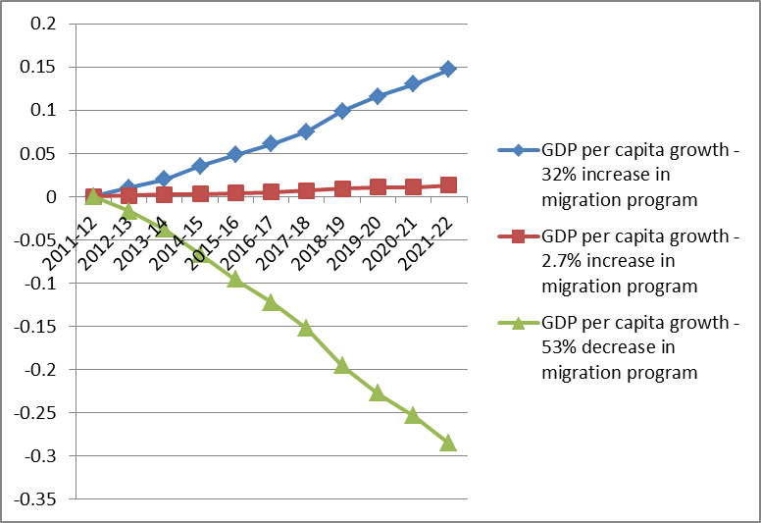
Macro results (three simulations)
Per capita income (percentage deviation from baseline)
Notes:
Per Capita Income (SLIDE THIRTEEN)
Per capita income is roughly calculated from the model’s output using GDP growth and population growth deviation. This model does not provide the per capita income directly.
Growth theory shows that it is labour supply per head of population that is relevant to understanding growth in income per capita.
It will always be difficult to determine exactly what effect migrant labour as a whole has on economic activity and hence GDP per head in the medium term.
There are two ways of approaching this question- The direct effect of migrants on employment and earnings; and their indirect effects on non-migrants workers.
The first way is to examine the contribution to GDP per head that an individual migrant make through his/her personal contribution to economic production.
If migrant gains employment and is earning at a rate above the national average they tend to raise GDP per head through a simple average effect.
Skilled migration offers three clear economic benefits:
It adds to the number of people of working age as they represent prime working age group.
It adds the proportion of people in workforce participation.
Skilled migrant increase GDP per capita vis increasing productivity. The higher the quality of immigrant skill, the greater the gain in productivity.

Slide 14
Macro results (three Simulations)
Real investment and capital stock (percentage deviation from baseline)
Notes:
Real Investment and capital stock (SLIDE FOURTEEN)
Physical capital adjustment to immigration may not be immediate. However, investor responds continuously to inflow of labour and to the consequent increase in the marginal productivity of capital. How fast they respond is an empirical question.
Capital stock adjust to maintain industries’ relative rates of returns.
The real wage adjust to ensure that employment move with the labour force.
Immigration induce employment is greater than immigration induced population growth.
What does this mean is that workforce participation rate of immigrants is higher than that of the pre-immigration population.
As the employment deviation is positive (when compared to the baseline), the labour/capital ratio rises (i.e. there are more units of labour available per unit of capital) relative to the baseline. This increase in the labour/capital ratio causes the rate of return on capital to increase relative to the baseline. The DIAC-TERM model assumes a positive relationship between investment and rates of return. As the rate of return on capital is higher than the baseline, the investment in capital will increase, leading to an increase in the capital stock.

Slide 15
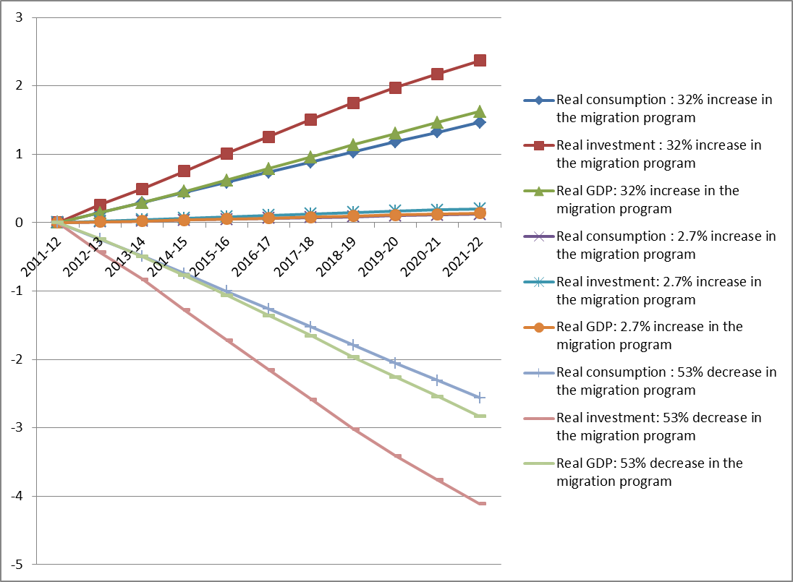
Real consumption, real investment and real GDP all Sims
(percentage deviation from baseline)
Notes:
SLIDE FIFTEEN
Above chart reports the deviations in real GDP and the components of domestic absorption (i.e. investment, consumption (i.e. both public and private)) for the three simulations for 2012-13 and 2021-22. Figure illustrates over the 11 year horizon, how the deviations in real GDP and the components of domestic absorption will change.
We have shown a positive deviation in capital stock. This deviation in capital stock is partly funded by borrowing from overseas. Interest payments on these borrowings from offshore gradually dampen the real consumption deviation relative to the real GDP deviation above. This partly explains why real consumption and real GDP deviations track closely in the early years of the simulation, but over time, the real consumption deviation tracks below the real GDP deviation.

Slide 16
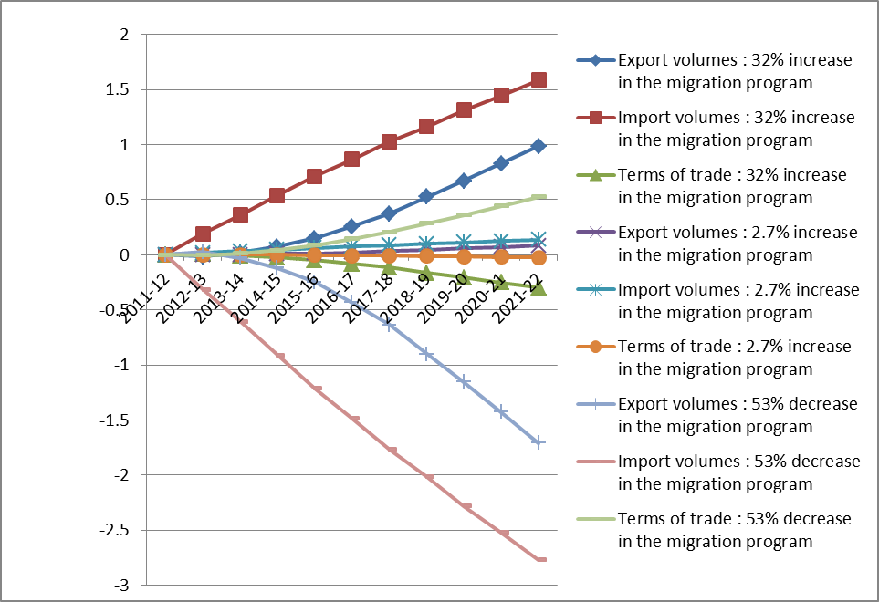
Export, import and the terms of trade (all Sims.)
(percentage deviation from baseline)

Slide 17
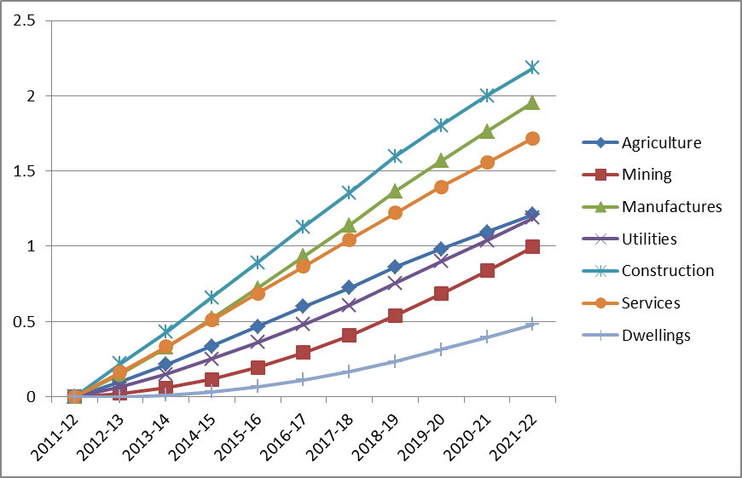
Sectoral output (32% increase)
Sectoral output 32% increase simulation
(percentage deviation from baseline)
Notes:
SLIDE SEVENTEEN
The DIAC-TERM model contains 36 industries. To facilitate the reporting and discussion of results, the outcomes have been aggregated to seven broad sectors.
Earlier slide (macro results) shows that the deviation in employment exceeds the deviation in the capital stock. Broadly, this macro outcome is also reflected in the sectoral results, as deviations in the output of labour-intensive sectors tend to exceed the deviations in the output of capital-intensive sectors.
For all scenarios, the more labour intensive industries, i.e. construction, manufacturing and services’ output are above the GDP deviations. The construction sector experiences the largest initial deviation in output and employment. This reflects the strong positive deviation in aggregate investment.
The manufacturing and services sectors also experience strong positive output and employment deviations. For manufacturing, this outcome reflects its relative labour intensity. In the case of services, its strong output deviation reflects two factors. First, it sells a high proportion of its outputs to public and private consumption. As a result, there is a tendency for the sector to closely track the output deviation for aggregate real consumption.
As discussed before, the real consumption deviation closely tracks the real GDP deviation. Second, the sector benefits from an improvement in its relative cost position because it is relatively labour intensive.
The more capital intensive industries, i.e. utilities, mining and agriculture’s output are below the real GDP and employment deviations. This reflects the relative capital intensity of these sectors. Further to this, both mining and agriculture sell a high proportion of their output as exports. As discussed, the export volume deviation lies below the real GDP deviation. With prospects for agriculture and mining largely governed by prospects for aggregate export volumes, we see the output deviations for these sectors lying below the real GDP deviation.
As the most capital-intensive sector, the dwellings sector experiences the lowest output deviation.

Slide 18
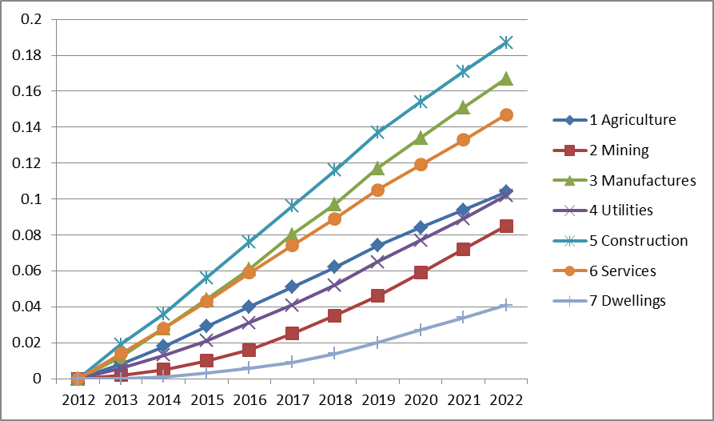
Sectoral output (2.7% increase simulation)
(percentage deviation from baseline)

Slide 19
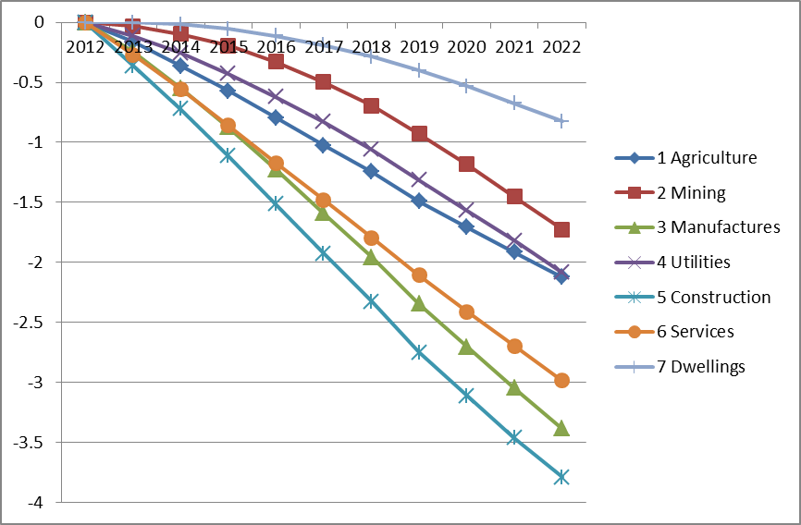
Sectoral output (53% decrease simulation)
Per capita income (percentage deviation from baseline)
Notes:
SLIDE NINETEEN
Sectoral output for 53% reduction in the migration program (SLIDE TWETY-EIGHT)
Note all sectors output decline due to the reduction in the program. The construction has experienced the worst output reduction followed by manufacturing and services. The least affect by this policy was dwelling. The results is mirror effects of the 32% increase policy scenario explained in the first scenario.

Slide 20
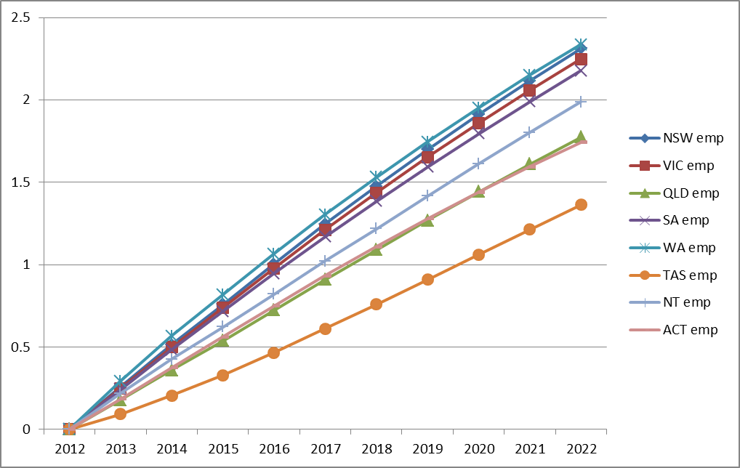
Regional Employment (32% increase simulation)
Employment, by state (percentage deviation from baseline)
Notes:
Regional Employment Effects (SLIDE TWENTY)
The economic effects of increased and/or decrease skill migration program also would have different outcomes across the states and territories because their sectoral composition varies and therefore skilled migration affects each region differently.
For example, mining, construction and agriculture are relatively more important to Western Australia.
The DIAC-TERM model contains 15 regions: the ACT, the capital cities and state balances for the remaining seven states and territories. The regional results from the different scenarios largely reflect the destinations of the new arrivals. As the different scenarios shock different visa groups and as different visa groups have different regional settlement patterns, the resulting regional distribution for the each scenario is slightly different.

Slide 21
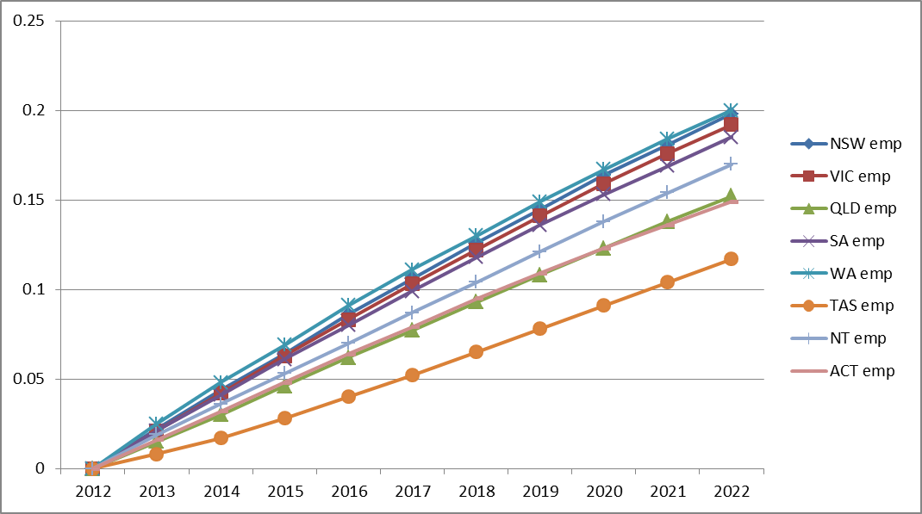
Regional Employment (2.7% increase simulation)
Employment, by state (percentage deviation from baseline)
Notes:
SLIDE TWENTY ONE
Consistent with the steady attenuation of the national employment deviation, we see slow increase in the state and territories level employment deviations. This reflects the same phenomenon underlying the steady increase of the national employment deviation

Slide 22
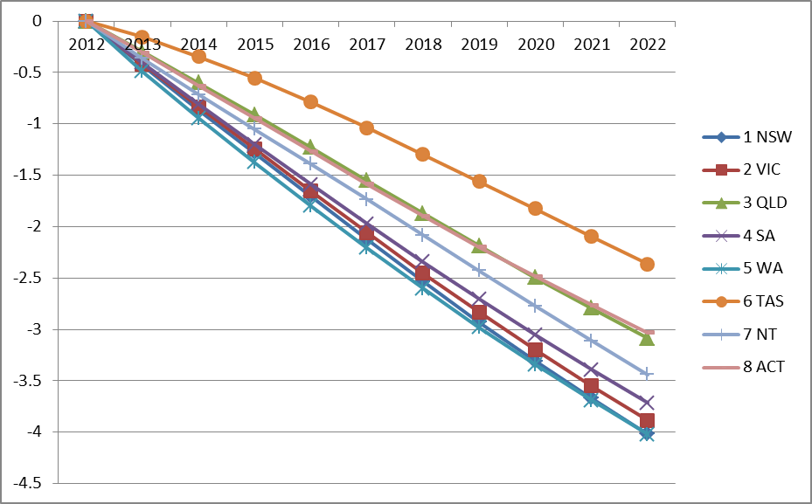
Regional Employment (53% decrease simulation)
Employment, by state (percentage deviation from baseline)
Notes:
SLIDE TWENTY TWO
The model contains 15 regions: the ACT and capital cities and state balances for the remaining seven states and territories. Figure above reported employment for all states and territories.
In the first year of the simulation, the largest employment negative deviations are experienced all regions.
The four regions experiencing the largest negative deviations in employment are WA, Victoria, SA and NSW.
Consistent with the steady attenuation of the regional output deviation in the state level employment deviations were experienced by all regions as a results of a reduced migration.

Slide 23
Questions and conclusion
Consistent with other CGE studies this analysis found that migration impacts on the economy is minimal, albeit positive
There are cautions to be exercised in applying this results for policy making decision due to its limitations.
This model assumes constant return to scale technology in the production structure.
It is also assumes that immigrants and resident workers are perfectly substitutable.They do not complement each other.

