Slide 1

QGEMF’s Regional Disaggregation Facility
Theory and Methodology

Slide 2
Contents
Overview
Derivation of regional activity
Derivation of activity for SEQ
Derivation of regional employment
Links to demography

Slide 3
Overview
Facility for disaggregating state-level estimates from QGEMF to planning regions
Derived from MMRF’s tops-down facility with assistance from Phillip Adams
Purpose:
  Assist planning (eg SEQ regional plan)
  Provide one, consistent set of Queensland Government projections
  Future policy analysis?
Notes:
QGEMF’s regional disaggregation facility provides projections of activity by 122 industries and 21 regions [point out DIVTOT].
Base year regional industry activity has been taken from Queensland Treasury and Trade’s estimates of Gross Regional Product. Changes in each industry’s regional activity are then determined depending on what kind of industry is being modelled. This is based on the regional disaggregation of activity in the Centre of Policies Studies MMRF model. Industries are split into “national” industries, where activity is driven by external factors and “local” industries where activity is driven by local factors.
The MMRF regional disaggregation is modified to
A separate treatment is also applied to a number of regions that are geographically close. The activity of local industries in these regions is highly correlated with activity in neighbouring regions and this is accounted for in the model.

Slide 4
Overview
Key modifications allow:
More differentiated treatment for the drivers of regional activity;
the disaggregation of employment to a place of work and place of residence (journey to work);
The linking of employment related effects to place of residence employment; and
Special treatment for metropolitan regions.
We welcome your feedback!
Notes:
QGEMF’s regional disaggregation facility provides projections of activity by 122 industries and 21 regions [point out DIVTOT].
Base year regional industry activity has been taken from Queensland Treasury and Trade’s estimates of Gross Regional Product. Changes in each industry’s regional activity are then determined depending on what kind of industry is being modelled. This is based on the regional disaggregation of activity in the Centre of Policies Studies MMRF model. Industries are split into “national” industries, where activity is driven by external factors and “local” industries where activity is driven by local factors.
The MMRF regional disaggregation is modified to
A separate treatment is also applied to a number of regions that are geographically close. The activity of local industries in these regions is highly correlated with activity in neighbouring regions and this is accounted for in the model.

Slide 5
Derivation of regional activity
Base year data from Queensland Government gross regional product estimates
Theory derived from the MMRF idea that regional demand is sourced from either:
  Outside the region (“national industries”)
  From within the region (“local industries”)
Notes:
QGEMF’s regional disaggregation facility provides projections of activity by 122 industries and 21 regions [point out DIVTOT].
Base year regional industry activity has been taken from Queensland Treasury and Trade’s estimates of Gross Regional Product. Changes in each industry’s regional activity are then determined depending on what kind of industry is being modelled. This is based on the regional disaggregation of activity in the Centre of Policies Studies MMRF model. Industries are split into “national” industries, where activity is driven by external factors and “local” industries where activity is driven by local factors.
The MMRF regional disaggregation is modified to
A separate treatment is also applied to a number of regions that are geographically close. The activity of local industries in these regions is highly correlated with activity in neighbouring regions and this is accounted for in the model.

Slide 6
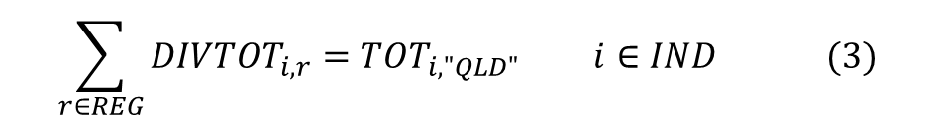
The adding up condition
The sum of regional activity for an industry is constrained to State activity for that industry
Notes:
The sum of regional activity for an industry is always constrained to State activity for that industry. This is called the adding up condition, which is presented in equation (1) where TOT is activity by industry and State.
Equation (2) presents the linearised form of equation (1) used in the model.
In equation (2) PRIM is value added at factor cost by industry and State and DIVPRIM is the value added at factor cost by industry and region.
For simplicity, only QLD regions are covered in this presentation.

Slide 7

Regional activity for “national” industries
Driven by external factors e.g. foreign demand
Regional activity linked to State-wide activity
In levels:
In per cent change form:
Notes:
National industries are those that mainly produce commodities that are used outside of the region. For example the output of the coal industry in Queensland is mainly exported, so foreign demand is the main determinate of activity for this industry. The activity of national industries is linked to the demand for the goods and services produced by these industries in the core of the model. This is shown in (3):
The variable OUTADJUST is allowed to move to ensure that the adding up condition holds.
NATIND is a subset of IND, covering the set of national industries.
Equation (4) represents the linearised form of equation (3)
The variable divtotshift allows for the exogenous specification of regional activity in an industry where further information is available that indicates that the movement in activity for that industry in a specific region will differ from State‑wide movements in activity. For example in our current project divtotshift is used to increase activity in the coal industry in the Central West Queensland region to account for assumed development of the Galilee coal basin over the projection period.

Slide 8


Regional activity for standard “local” industries
Driven by local expenditure
  Employment used as a proxy for income
Regional activity linked to regional employment
In levels:
In per cent change form:
Notes:
Local industries are differentiated from national industries since demand for their goods and services are expected to be driven by local factors rather than external factors. For example the activity of the Auto Repair industry is mainly dependent on expenditure within the region. Under the standard treatment of local industries, the activity of local industries is driven by regional income, where total regional employment is used as a proxy for income. Equation (5) presents the standard theory for determining local industry activity where s represents place of residence, DIVEMP_I is regional employment by place of residence, EMP_I is State employment by place of residence, LOCIND is a subset of IND covering local industries and STREG is a subset of REG containing regions covered by the standard treatment. I.e. STREG doesn’t include the geographically close regions, which are treated later.
The standard theory for determining regional activity is derived from MMRF but has been adapted to include employment on a place of residence basis, i.e. it is assumed that most expenditure occurs in the region where workers reside, not where they work.
Under the standard treatment, equation (5) introduces local multiplier effects into regional local demand. Specifically, for local industry i in region s, local activity relative to state-wide activity is proportional to the ratio of employment in region s to aggregate state-wide employment. This means that as growth in region-level employment accelerates above growth in state-level employment, activity of region-level local industries increases relative to state-level activity of those industries.
Equation (6) is the linearised form of equation (5) where emp_i_pow is the per cent change in State employment by place of residence, xpersons_oir is the per cent change in persons employed by place of residence.
Outadjust moves to ensure the adding up condition holds.

Slide 9

Treatment for “government” industries
Driven by local population
Regional activity linked to regional population
Notes:
There are a number of local industries that have been treated differently to the standard treatment of local industries. The first of these are so called government industries. These are industries that provide services to the broader community and so for these industries it was considered that the appropriate driver of activity is the resident population. For example the Public Safety industry provides services to persons regardless of their employment status.
Equation (7) introduces population induced effects into regional local demand for government industries. Specifically, for industry i in region s, local activity relative to state-wide activity is proportional to the ratio of population in region s to aggregate state-wide population. This means that as growth in region-level population accelerates above growth in state-level population, activity of region-level “government” industries increases relative to state-level activity of those industries.
The model representation of equation (7) is shown in equation (8).
Regional population is determined exogenously and is consistent with the Queensland Government’s population projections.

Slide 10

Treatment for Education and Residential and Child Care
Driven by the population accessing the services produced by these industries
Regional activity linked to population of prime education age (4 to 25) or using child care (0 to 4) or aged care (75+) facilities
Notes:
For the Education and Residential and Child Care industries, the appropriate driver of activity is the proportion of the population consuming the services provided by these industries.
Under the regional disaggregation facility, activity of the Education industry in each region is determined by movement in the population of prime education age and activity of the Residential and Child Care industry is determined by movement in the population using child care and aged care facilities.
Equations (9) and (10) present the treatment of the Education industry, however the same treatment is applied to the Residential and Child Care industry.
In equation (9), DIVPOPEDU is the size of the population aged 4 to 25 in each region and POPEDU is the size of the population in the State aged 4 to 25. Equation (9) says that for the Education industry in region s, local activity relative to state-wide activity is proportional to the ratio of the population aged 4 to 25 in region s to the aggregate state-wide population aged 4 to 25. This means that as growth in region-level population aged 4 to 25 accelerates above growth in state-level population aged 4 to 25, activity of the Education industry in that region increases relative to state-level activity of the Education industry.
The linearised form of equation (9) is presented in equation(10) where divpopedu and popedu are the per cent change forms of DIVPOPEDU and POPEDU. At all times the adding up condition continues to hold.

Slide 11
Treatment for Agricultural Services
Driven by activity in other agricultural industries
Regional activity linked to growth in the mix of other agricultural industries in the region
Notes:
The Agricultural Services industry produces services that are mainly used by other agricultural industries. For this reason it is appropriate to drive movements in Agricultural Services with movements in agricultural activity by region.
First, equation (11) determines agricultural activity for each region. DIVTOT_AG is the regional activity of all agricultural industries combined (excluding Agricultural Services) and AGIND is the set of those industries.
Activity of the Agricultural Services industry is then determined by agriculture activity in equation (12).
The other agricultural industries are all modelled as national industries (see Table 1), as such the activity of each agriculture industry will grow at the same rate across all regions. With the mix of agricultural industries varying between regions, DIVTOT_AG will grow faster in those regions with a greater proportion of faster growing agricultural industries. Hence, equation (12) will increase regional activity of the Agricultural Services industry in those regions with a greater proportion of faster growing agricultural industries relative to the State. Equations (11) and (12) are represented in per cent change terms in the model as equations (13) and (14).

Slide 12

Treatment for Civil Construction
Driven by engineering construction work
First regional investment in engineering construction work is determined
Notes:
The activity of the Civil Construction industry is driven by regional engineering construction work.
Regional investment by industry in engineering construction work needs to be determined first and then activity for the Civil Construction industry can be determined.
Base year engineering construction work by industry [DIVCONSINV] is mechanistically constructed outside the model and then projected changes are determined by equation (15).
In equation (15), INV is state-wide engineering construction work by industry, INVSHIFT is used to generate additional investment in an industry within a region, where we have made assumptions regarding future investment in that region in that industry and INVADJUST is allowed to move in to ensure that the adding up condition in equation(16) holds.
Finally aggregate investment in engineering construction work [DIVCONSINV_I] is determined for each region by equation (17).

Slide 13



Treatment for Civil Construction
Notes:
These equations present the per cent change forms of the equations on the previous slide.
Looking at equation (18), divconsinv, inv and invadjust are the per cent change forms of DIVCONSINV, INV and INVADJUST. invadjust moves to ensure the adding up condition in equation (19) holds.

Slide 14
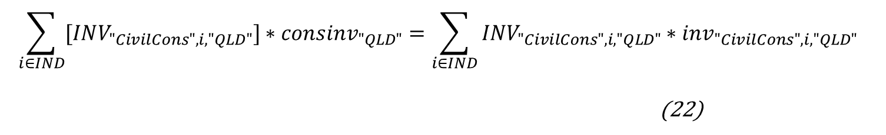
Treatment for Civil Construction
Then State-wide engineering construction work is determined
Notes:
With regional engineering construction work determined, activity of the Civil Construction industry can be determined. Firstly, state-wide engineering construction work is determined from the core of the model, as shown in equation (21). Equation (22) is the per cent change form of equation 921) as presented in the moel.
CONSINV is state-wide investment in engineering construction.

Slide 15
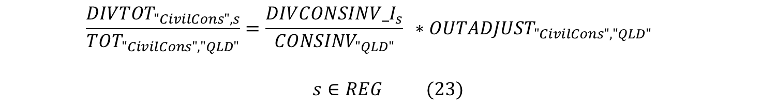
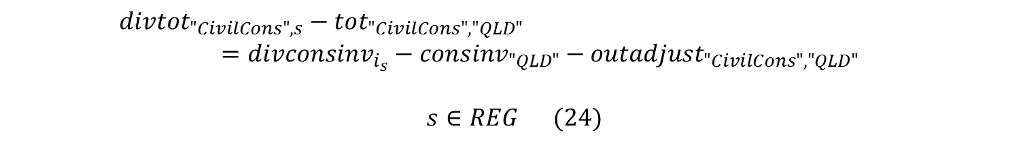
Treatment for Civil Construction
Finally, regional Civil Construction activity is linked to regional engineering construction work
Notes:
Finally, regional activity of the Civil Construction industry is determined in equation (23).
Equation (23) introduces investment effects into regional Civil Construction industry demand. Specifically, for the Civil Construction industry in region s, local activity relative to state‑wide activity is proportional to the ratio of engineering construction work in region s to aggregate state-wide engineering construction work. This means that as growth in region-level engineering construction work accelerates above growth in state-level engineering construction work, activity of the Civil Construction industry in that region increases relative to state-level activity of the Civil Construction industry. Equation (24) is the model representation of equation (23).

Slide 16

Treatment for Construction Services
Driven by activity in other construction industries
Regional Civil Construction activity is linked to regional activity of other construction industries
Notes:
The Construction Services industry produces services that are largely used by other construction industries. As such Construction Services is treated in a similar way to Agricultural Services, with movements of construction activity in a region driving movements in the Construction Services industry.
Total construction activity is the sum of the activity of all construction industries not including the Construction Services industry. This is presented in equation (25).
DIVTOT_CONS is the regional activity of all construction industries excluding Construction Services. CONSIND is the set of construction industries.
Activity of the Construction Services industry is then determined in equation (26).
The mix of construction industries will vary for different regions and individual construction industries are growing at different rates, so DIVTOT_CONS will grow faster in those regions with a greater proportion of faster growing construction industries. Hence, equation (26) works to increase regional activity of the Construction Services industry in those regions with a greater proportion of faster growing construction industries relative to the State.
Equations (27) and (28) translate equations (25) and (26) into the linearised per cent change form used in the model.

Slide 17
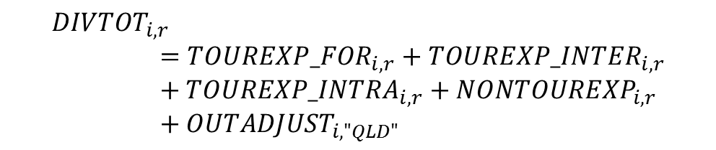

Treatment for “tourism” industries
Driven by foreign tourism, domestic tourism and non-tourism expenditure
Regional activity linked to regional shares of foreign tourism, domestic tourism and non-tourism expenditure
Notes:
Regional activity for “tourism” industries is determined by the shares of foreign, interstate and intrastate tourism expenditure and non-tourism expenditure in each tourism industry in each region. These shares have been determined outside the model.
In equation (29) TOUREXP_FOR is foreign tourism expenditure, TOUREXP_INTER is interstate tourism expenditure, TOUREXP_INTRA is intrastate tourism expenditure and NONTOUREXP is non-tourism expenditure for the “tourism” industries. TOURIND is the set of “tourism” industries. For those regions where a greater proportion of expenditure comes from those sources that are growing more strongly, the activity of tourism industries will grow faster relative to the State.
“Tourism” industries are those industries with a high share of activity fuelled by tourism demand, i.e. the Accommodation and Food and Beverage industries

Slide 18
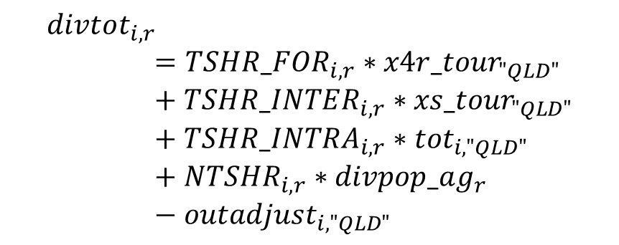

Regional activity for “tourism” industries
Notes:
Equation (29) is written in per cent change terms in the model as equation (30).
TSHR_FOR, TSHR_INTER, TSHR_INTRA and NTSHR are the shares of activity driven by foreign tourism, interstate tourism, intrastate tourism and non-tourism respectively in each region. They add up to one for each tourism industry in each region.
The core of the model contains variables which account for the different drivers.
x4r_tour is the per cent change in the exports of a bundle of goods that are used by tourists,
xs_tour is the per cent change in the interstate exports of a bundle of goods that are used by tourists,
tot is the per cent change in state-wide activity of the tourism industries, which is used here as a proxy for the per cent change in tourism industry activity driven by intrastate tourism, and
divpop_ag is the per cent change in regional population, used here to drive the share of tourism industry activity that comes from non-tourism expenditure.

Slide 19
Treatment for metropolitan areas
Metro area treated as a single region. E.g.:

Slide 20
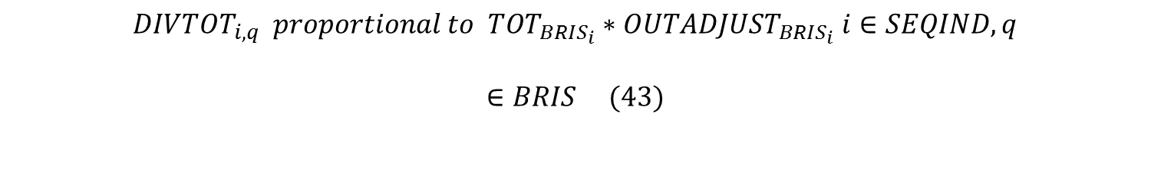
Regional activity for metropolitan areas
Within the metro region:
and

Slide 21
Regional activity for metropolitan areas
We include an additional exogenous variable, selfcontain(i,q), to allow the imposition of additional local information
in per cent change form:

Slide 22

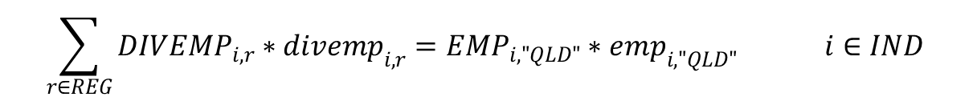
Regional Employment - POW
First determine place of work employment:
In levels:
In per cent change form:
Adding up condition (per cent change form):

Slide 23

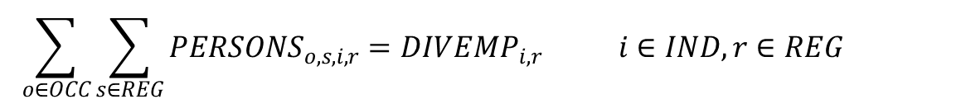
Regional Employment - POR
Then determine place of residence employment
First note:
The ratio of persons employed in region,r working in region, s can change but:

Slide 24
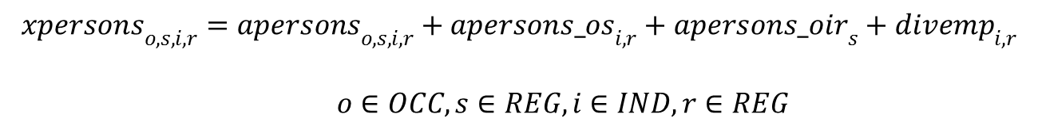
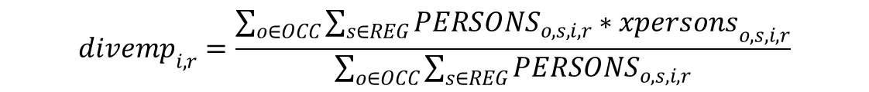
Regional employment - POR
We can write this (in per cent change form) as:

Slide 25
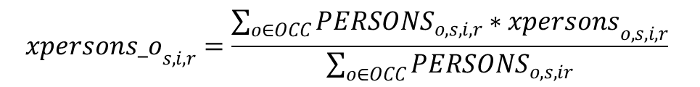
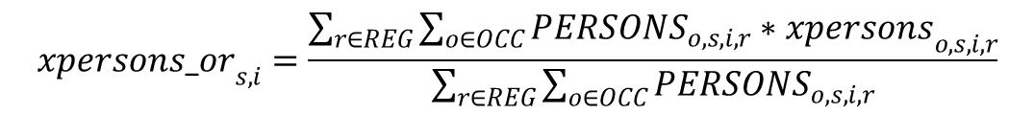
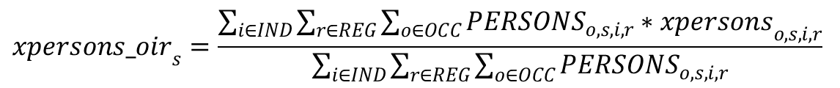
Summary variables

Slide 26

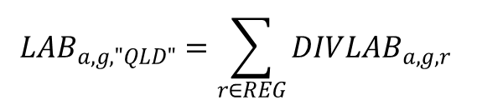
Regional Demography
Regional labour supply determined by regional population and participation (by age and gender)
Constrained by state labour supply

Slide 27
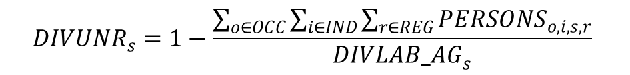
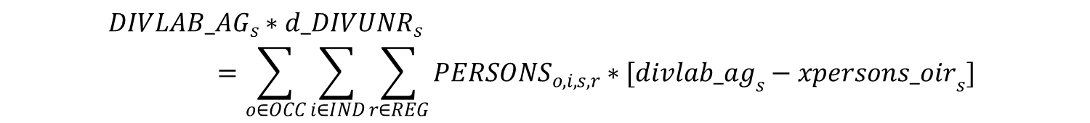
Regional unemployment
Regional unemployment defined as:
Where DIVLAB_AG is the sum of DIVLAB by age and gender.
In per cent change form:

Slide 28
Reconciling demographic and economic projections
With the ratio of place of work/place of employment fixed, we may get large shifts in regional unemployment rates
2 causes:
Inconsistencies between the assumptions used in the demographic and economic models; and
Dispersion of populations in regions that result in changes in the locations of work and residence (e.g. in fast growing metropolitan regions)

Slide 29
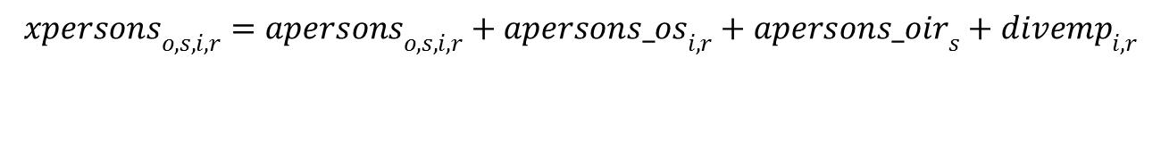
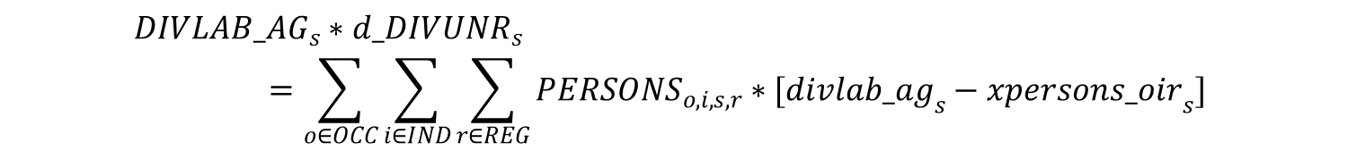
Reconciling demographic and economic projections
To address 2:

Slide 30
Applications
Improve demographic projections
Consistent set of regional projections across state
Understand implications of planning agencies push for residential development in outer suburbs

